Slide 1
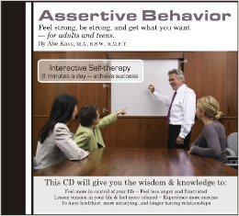
ASSERTIVE BEHAVIOUR
Dr J Balamurugan

Slide 2
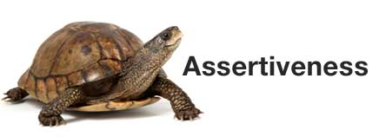
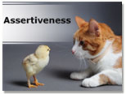
WHAT IS ASSERTIVENESS?
Assertiveness is about self confidence.
Assertiveness is the ability to communicate your needs, feelings, opinions, and beliefs in an open and honest manner without violating the rights of others.
Having a positive attitude towards yourself and others.

Slide 3
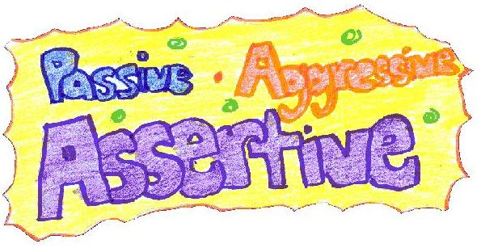
TYPES OF BEHAVIOUR
Assertive behaviour
I am ok,you are ok
Non-assertive (passive) behaviour
I am not ok,you are ok
Aggresive behaviour
I am ok,you are not ok
Manipulative behaviour
I am not ok,you are not ok

Slide 4
Assertive Behaviour
To act in one's own best interest
To stand up for oneself
To express honest feelings comfortably
To exercise personal rights
To not deny the rights of other
Being honest

Slide 5
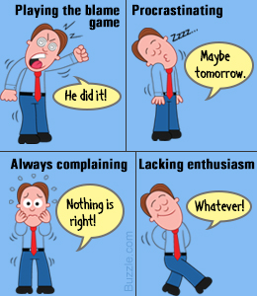
Negative attitude and passive behaviour
Lack of self confidence and low self esteem
Lack of self respect
Self putdowns
Negative feelings and thoughts about himself
Feelings of inferiority.
Like others to be in control of people and situations.
Feelling guilty.
De-motivated.

Slide 6

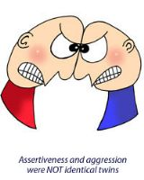
Negative attitude and aggressive behaviour
Lack of self confidence and lack of self esteem
Lack of respect towards others
Put others down
Feelings of superiority
Like to be in control of people and situations
Disinterested in others’ thoughts and feelings
Feel angry towards others and are quick to blame them
Don’t listen to or ask questions
Dismissive of feedback

Slide 7

Negative attitude and manipulative behaviour
Lack of self confidence and low self esteem
Lack of self respect and lack of respect for others
Mistrustful and suspicious of others’ motives
Negative feelings and thoughts about self and others
Feel very wary towards others
Dishonest and indirect
Undermine others’ self esteem
Depressed and demotivated

Slide 8
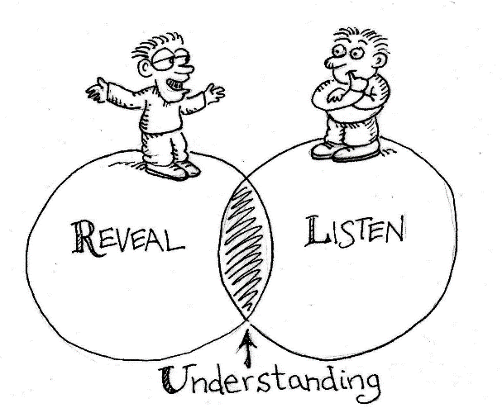
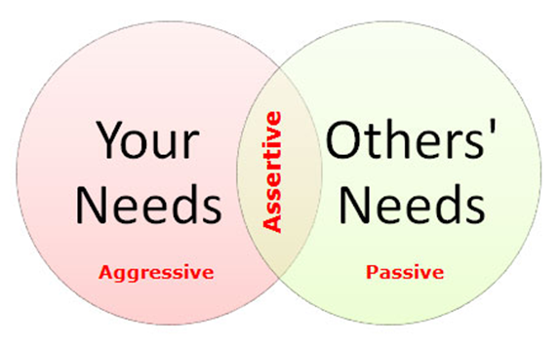
Positive attitude and assertive behaviour
Self confidence and high self esteem
Respect for self and towards others
Take responsibility for self
Motivated to do a good job
İnterested in others’ feelings and thoughts
Ask questions
Honest and direct
Listen to others
Ask others for feedback

Slide 9
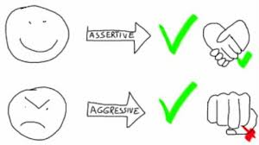
Being Assertive
Being assertive is focusing on your goal.
Being assertive is being self-aware.
Being assertive is being true to yourself.
Being assertive is building self esteem.
Being assertive is nurturing yourself.

Slide 10
HOW TO BE ASSERTIVE
Be honest and direct about your feelings, needs, beliefs.
Express yourself directly to specific individuals.
Be reasonable in your requests
Be honest when giving or receiving feedback.
Learn to say “no” to unreasonable expectations.
Recognize and respect the rights of those around you.

Slide 11
HOW TO BE ASSERTIVE
Use appropriate tone of voice.
Be aware of body posture/language
Maintain eye contact.
Use “I” statements to express self
Don’t let others impose their values/ideas on you
Encourage others to be clear and direct
Take ownership

Slide 12
ASSERTIVENESS BY VERBAL AND NONVERBAL COMMUNICATION
Faces and the looks
Eye signal
Body image
Personal space
The gesture

Slide 13
Assertive rights
You have the right to be treated with respect and dignity.
You have the right to have and express your own feelings and opinions.
You have the right to be listened to and taken seriously.
You have the right to judge your own behaviour, thoughts and emotions, and to undertake the responsibility for their initiation, and consequences upon yourself.
You have the right to make mistakes and be responsible for them.
You have the right to say : "I don't know".
You have the right to say : " I don't understand."
You have the right to ask for information (including from professionals).

Slide 14
Assertive rights
You have the right to change your mind.
You have the right to be independent to the goodwill of others before coping with them.
You have the right to get what you pay for.
You have the right to choose your profession.
You have the right to practice your own religion.
You have the right to ask for what you want (realising that the other person has the right to say `no').
You have the right to acquire knowledge.
You have the right to say `No' without feeling guilty.

Slide 15
SAYING ‘YES’ OR ‘NO’

Slide 16
Why is it difficult to say no?
If I say no,they may feel hurt or injected
If I say no this time, they may not like me anymore
If I say no this time,they may never ask again
They won’t take any notice if I say no
They would say ‘yes’ to me (and so I will feel guilty if I refuse them)
I can’t say no, because I feel sorry for them

Slide 17
How to say ‘no’ assertively?
Start your reply with a clear,firm,audible ‘no’
Do not justify or make excuses.Giving a reason is different from over-appologizing
Feel that you have a right to say no
Once you have said ‘no’ , do not stay around waiting to be persuaded to change your mind.
Remember you are saying ‘no’ to that particular request,not rejecting the person
Ask for more information if you need it in order to decide whether you want to say ‘yes’ or ‘no’

Slide 18
Why is it difficult to say ‘yes’?
I don’t deserve it.
They might not really mean it.
I am not really sure that is what I want.
I don’t have enough information.

Slide 19
How to say ‘yes’ assertively
Say ‘yes’ clearly and definitely.
Identify why you would find it difficult.
Examine thoughts realistically and ask yourself.
Having clarified thughts for yourself then reaffirm your desire to say ‘yes’.

Slide 20
Combining ‘Yes’ and ‘No’
‘Yes’ and ‘No’ may be combined assertively to define what we want or what our limits are in a particular situation.

Slide 21
THE IMPORTANCE OF ASSERTIVENESS IN ORGANISATIONS
Assertiveness
Personal identity
Wages or salary
Satisfaction from exercising skills
Satisfaction from helping people
Social environment
Need to deal with
Their selves
The manager to whom they report
Their colleagues
Their subordinates
Clients or customers

Slide 22
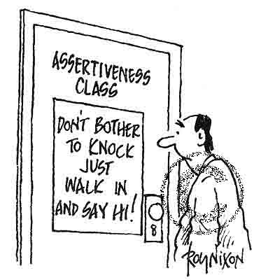

Slide 23
THANK YOU

